Slide 1
Let us go to mips
Session 4

Slide 2
What is MIPS?
It is not Million Instructions Per Second, here! ☺
Expanded as Microprocessor Without Interlocked Pipeline Stages.
It is an ISA with 32 bit instructions. (Means, all instructions are 32 bits wide)
It is completely RISC architecture. (Means, it is all about load and store)
Any RISC architecture would eventually support FIXED WIDTH instructions and it is actually beneficial (You will understand this soon)
A very important point to note is “All these instructions must be stored at “WORD-ALIGNED address”.
What is that?
Word aligned address means, the addresses are divisible by 4. (Must be, we shall learn more about this, shortly)

Slide 3
MIPS – How it all happened? From where did we reach MIPS?
How did it grow? It started with Motorola and Intel.
Motorola 6800 / Intel 8085 (1970s)
1-address architecture: ADDA <addr>
(A) = (A) + (addr)
Intel x86 (Early 80s)
2-address architecture: ADD EAX, EBX
(A) = (A) + (B)
MIPS architecture (Early 90s)
3-address architecture: ADD $2, $3, $4
($2) = ($3) + ($4)

Slide 4
Let’s understand this as well.
MIPS has the following design considerations.
It is designed with having high level languages in mind. Means, usage of high level languages is much easier with MIPS.
MIPS does not demand the programmer to learn many addressing modes or instructions. It is all simple here and one could learn MIPS with ease.
Increased parallelism and also classy pipelining supported in MIPS. (Remember the production lines)
100% Load and Store architecture.
Increased flexibility with providing more number of general purpose registers (Compare ARM with 8085 folks)
All instructions are 32 bits wide. Hence, there is a uniformity internally enabled.
Hardware design considerations are easier when it is all uniform.

Slide 5
MIPS Instructions
MIPS instructions are of the following types:
Arithmetic/logical/shift/comparison
Control instructions (branch and jump)
Load/store
Other (exception, register movement to/from GP registers, etc.)
Let us learn this one after another.
Again, classified as I Type, R Type, J Type instructions.
All the instructions shall fall under any of these instruction types.

Slide 6
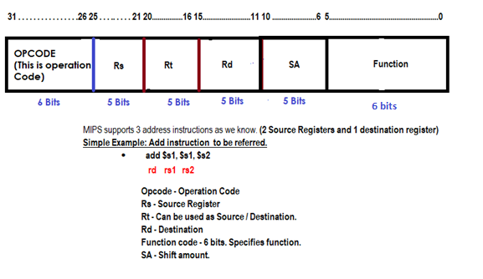
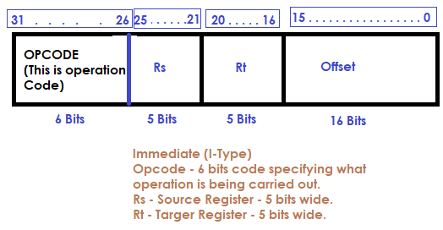
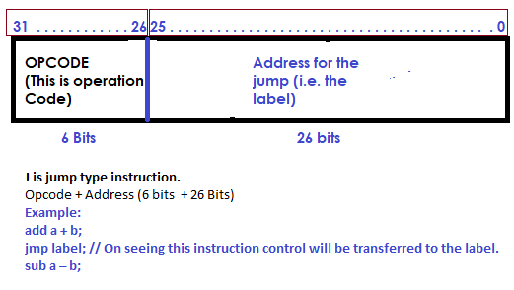
Let us understand how it looks like…
R Type

Slide 7
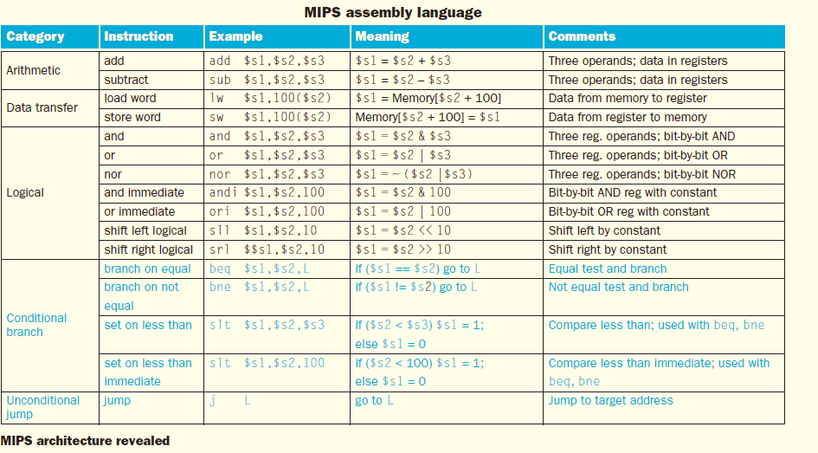
Contd.,

